Slide 2
Index
Attractions
Shopping
Weather
Transportation
Food
Lodging
References

Slide 3
Attractions
China House
New Style Town
Tianjin Old City
Tianjin Museum
Tianjin Ancient Culture Street

Slide 4
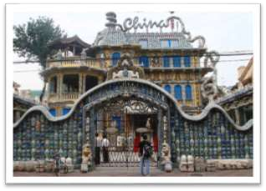
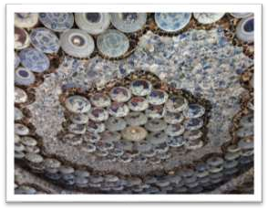
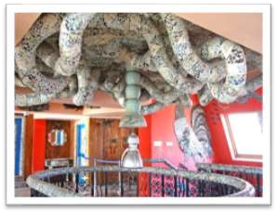
China House
China House
is a Porcelain House which is
decorated with about 4,000 pieces of ancient porcelain, 400 pieces of jade stone carving, 20 tons of crystal and with about million pieces of ancient Chinese ceramic chips.

Slide 5
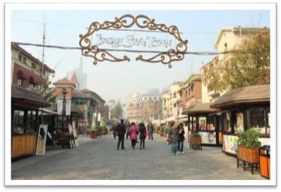
New Style Town
Tianjin Xin Yi Street is also known as the Italian Custom Area which was built during 1902. It covers the area from Coast area to the Victory Road.

Slide 6
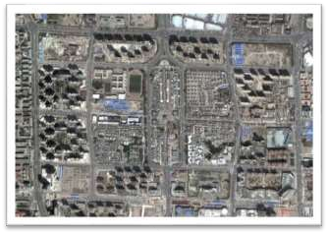
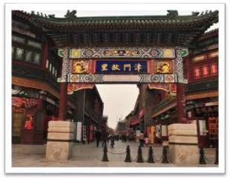
Tianjin Old City
Tianjin Old City is renowned for the magnificent colonial arinternationally chitecture dating far back to the Ming family of the 13th century.

Slide 7
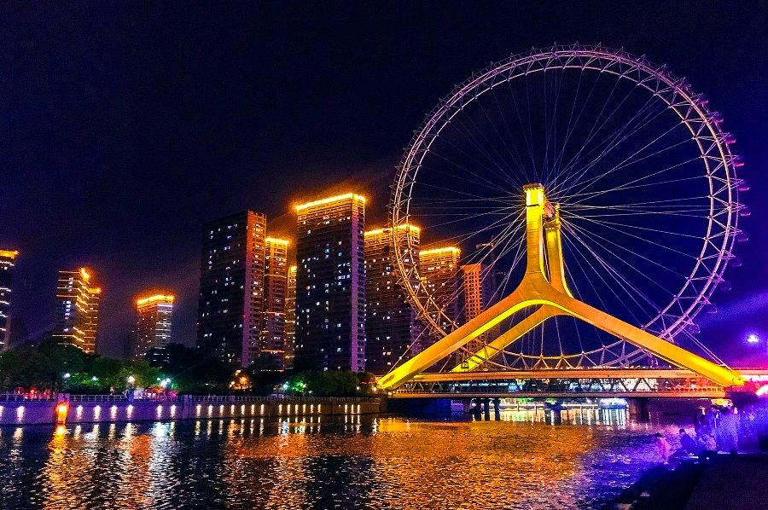
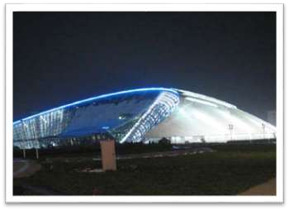
Tianjin Museum
Tianjin Museum stands on the Galaxy Plaza junction where the Friendship Road in Hexi District and Pingjiangdao Road meet. The museum is home to more than 200,000 books.

Slide 8
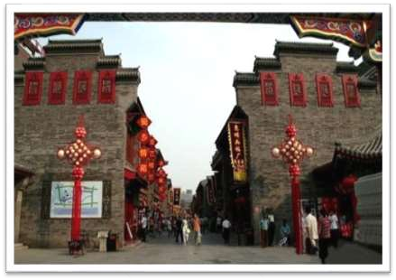
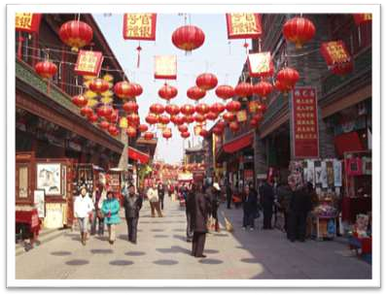
Tianjin Ancient Culture Street
Ancient Cultural Street is located in the Nankai District of the Tianjin Municipality. It is located on the west bank of the Haihe River, with Tianhou Palace as its geographical center.

Slide 9

Shopping
Tianjin is home to both modern shopping malls and
distinctive traditional stores,
A range of top malls and department stores can be found on these two streets such as Quanye Chang, Isten Department Store, Jinhui Shopping Square etc. out of which Quanye Chang is the most famous.

Slide 10
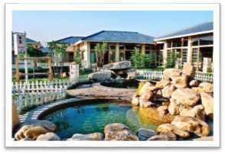
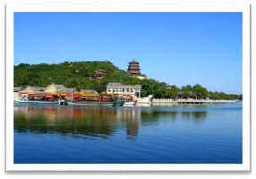
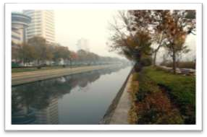
Weather
Spring - Spring is short in Tianjin, starts
in March and lasting only 50 to 60 days.
Summer - Summer in Tianjin starts in June. It is quite comfortable in June because even with a high temperature, the humidity is low.
Autumn - Autumn is only 60 days in Tianjin, and goes from mid-August to mid-October.
Winter -The average temperature in the winter
is -4 °C (23 °F). Winter in Tianjin can even last for over 160 days.

Slide 11
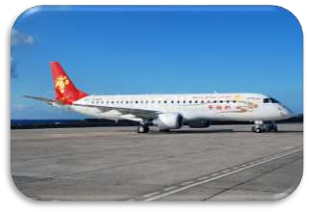
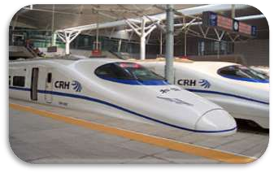
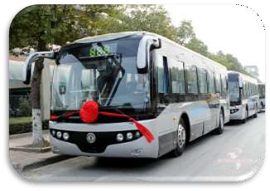
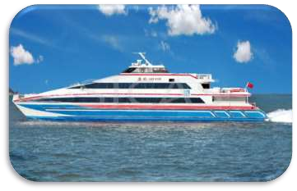
Transportation
Air
Railway
Coach / Bus
Waterway

Slide 12
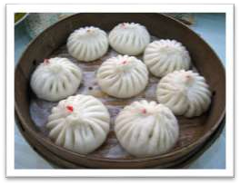
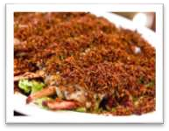
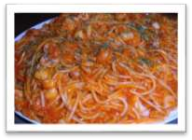
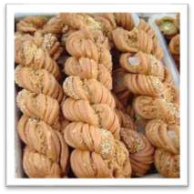
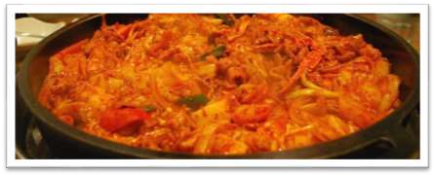
Food
Tianjin has a very famous food culture, and many people travel to Tianjin expect to taste these delicacies in Tianjin. Cuisines in Tianjin mainly includes river products and sea food.

Slide 13
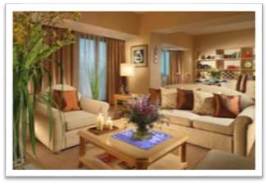
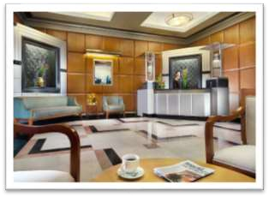
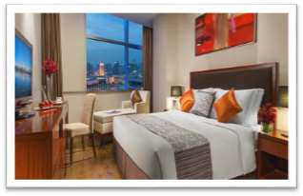
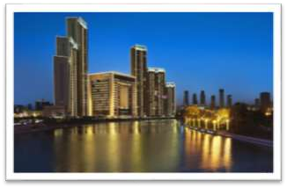
Lodging
Somerset Olympic Tower
Tianjin
Somerset International Building Tianjin
Somerset Youyi Tianjin
The St Regis Tianjin Hotel

Slide 14
References
http://t0.gstatic.com/images?q=tbn:ANd9GcSzMOtXK91iExXZ774cGBZ2xfSWF2b-8PqVDRtC21-XGMpfr0RD
•
•
•
•
•
•
•
•
•
•
•
•
•
•
•
•
•
•
•
•
http://www.visitourchina.com/FileUpload/FileUpload/110712174038093.jpg
http://www.udotrip.com/wp-content/uploads/img/781ab4b7.jpeg
http://maysblogs.tamu.edu/china/files/2012/06/IMG_1891.jpg
http://www.chinadaily.com.cn/travel/img/attachement/jpg/site1/20130808/002564bc654b136d96fb1d.jpg
http://www.bricoleurbanism.org/wp-content/uploads/2010/04/tianjin-old-city_2009-05_rev.jpg
http://www.china-tour.cn/images/China_Pictures/Tianjin-Pictures/Ancient-Culture-Street.jpg
http://assets.inhabitat.com/wp-content/blogs.dir/1/files/2011/01/tianjin-eco-city-8.jpg
http://www.visitourchina.com/FileUpload/FileUpload/110212165406580.jpg
http://www.topchinatravel.com/pic/city/tianjin/attractions/Tianjin-Museum-3.jpg
http://pic.enorth.com.cn/0/06/55/96/6559685_266149.jpg
http://www.visitourchina.com/FileUpload/FileUpload/100919175605484.jpg
http://www.chinadaily.com.cn/m/tianjin2011/images/attachement/jpg/site1/20111108/0023ae80a21210231be504.jpg
http://www.greatwallvacation.com/UploadFile/news/1268728993038.jpg
http://www.visitourchina.com/FileUpload/FileUpload/100919175605484.jpg
http://www.greatwallvacation.com/UploadFile/news/1268728993038.jpg
http://www.chinatraveldepot.com/PackageImages/shopping(10).jpg
http://renaissance-hotels.marriott.com/images/Shopping-Tianjin-Shengxifu_Hat_Shop-7xdypkj
http://img2.chinatraveldepotstatic.com/Hotel_Photo/OLD/piclib/9062/299063/overview.jpg
http://t2.gstatic.com/images?q=tbn:ANd9GcQBG8pF6TUTpjILcWcIcWchgT9Di9sI8bucs42E4mwyRBkeizgJ
http://t10.deviantart.net/T6PsY0Iw3CBlz6icKfrIN3P6 w=/300x200/filters:fixed_height(100,100):origin()/pre11/9fb5/th/pre/i/2010/123/8/b/
autumn_in_tianjin_by_charlie009.jpg
http://www.beijing-tours.cn/wp-content/gallery/beijing-tianjin-tanggu-expressway/beijing-tianjin-tanggu-expressway.jpg
•
http://airlinersgallery.smugmug.com/Airlines-Asia-3/Airlines-Asia3-QZ/Tianjin-Airlines/i-kh8JptG/0/M/Tianjin%20ERJ%20190-100%20B- 3152%20(09)(Grd)%20LPA%20(TAL)(46)-M.jpg

Slide 15
References Cont.
http://d2wk0ob0vlqll0.cloudfront.net/media/images/countries/china/tianjin/somerset_international_building/pagebanner/full_somerset_interna tional_building_tianjin_lobby.jpg
http://d2wk0ob0vlqll0.cloudfront.net/media/images/countries/china/tianjin/somerset_youyi/pagebanner/pbanner_somerset_youyi_tianjin_1_b
edroom_executive.jpg
http://q-ec.bstatic.com/images/hotel/840x460/248/24859448.jpg?the%20st.%20regis%20tianjin%20hotel%20tianjin%20china
http://www.visitourchina.com/FileUpload/Guide/City/100919171059.jpg
•
•
http://www.seriouseats.com/assets_c/2014/09/201400929-fu-run-lamb-max-falkowitz-thumb-625xauto-412182.jpg
http://q- ec.bstatic.com/images/hotel/840x460/810/8109926.jpg?the%20astor%20hotel,%20a%20luxury%20collection%20hotel,%20tianjin%20hotel% 20tianjin%20china
http://www.ca.kayak.com/rimg/himg/03/41/22/leonardo-1140376-Living_Room-Somerset_Olympic_Tower_S- image.jpg?width=502&height=334
http://t3.gstatic.com/images?q=tbn:ANd9GcT0x0zFYk9oyl5tlxoW_gLawRo6bv5HIyNdY9Uw4UjxhHum5XIXyw
•
•
•
•
•
•
•
http://upload.wikimedia.org/wikipedia/commons/thumb/5/5f/T001_TianjinTrainStation.jpg/300px-T001_TianjinTrainStation.jpg
http://www.whatsontianjin.com/news_images/5532electric%20bus.jpg
http://t3.gstatic.com/images?q=tbn:ANd9GcToYq92oN90VvMLY5u7dkB836hNxpV8hazvvyZiXrixD05Qi72Y
http://www.echinacities.com/userfiles/2011-Year/1-Month/10-Day/image004(1).jpg
http://renaissance-hotels.marriott.com/images/Food-Tianjin-Tairyo-qkgqlpfn
http://www.topchinatrip.com/upload/imgs/China/1012075528%E5%A4%A9%E6%B4%A5.jpg
http://www.tour-beijing.com/blog/wp-content/uploads/The-Italian-Town-architecture.jpg

Slide 16
Thank You
Created by Pushpitha Wijesinghe

